Slide 1
HybridSN: Exploring 3-D–2-D CNN Feature Hierarchy for Hyperspectral Image Classification
Submitted By:-
22M0320-Radhanath Nayak
22M0328-Siddharth Bhanja
22M0329- Tausif Shahanshah
Submitted To:-
Prof.Biplab Banerjee

Slide 2
Methodology
Input Image
PCA
Neighbourhood Extraction
3D Convolution
2D Convolution
Flattening
Fully Connected Neural Network
Classification
Output Image

Slide 3
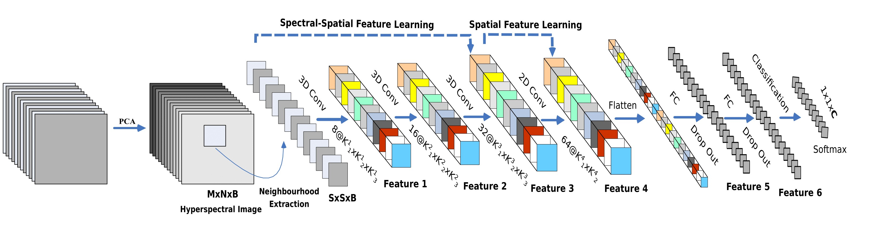
Work Flow
Reference

Slide 4
Principal Component Analysis
It is a statistical method used to reduce the dimensionality of a dataset by finding the most important features or components that explain the most variance in the data.
The goal of PCA is to transfer a dataset of possibly correlated variables into a set of uncorrelated variables, called principal components, that retain most of the information of the original dataset.
This is achieved by finding the eigenvectors and eigenvalues of the covariance matrix of the dataset.

Slide 5
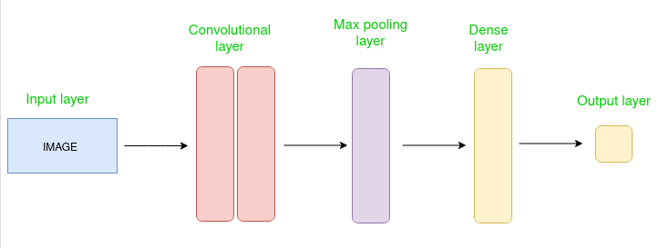
Convolutional Neural Network
CNN consists of multiple layers like the input layer, Convolutional layer, Pooling layer, and fully connected layers.
CNN models to train and test, each input image will pass it through a series of convolution layers with filters (Kernels), Pooling, fully connected layers (FC) and apply Softmax function to classify an object with probabilistic values between 0 and 1.
Reference

Slide 6
Hybrid Spectral CNN
Hybrid Spectral CNN is a spectral-spatial 3-D-CNN followed by spatial 2-D-CNN.
The 3-D-CNN facilitates the joint spatial-spectral feature representation from a stack of spectral bands.
The 2-D-CNN on top of the 3-D-CNN further learns more abstract-level spatial representation.
Moreover, the use of hybrid CNNs reduces the complexity of the model compared to the use of 3-D-CNN alone.

Slide 7
Dataset Description
Input Data : HSI data set is Indian Pines (IP).
IP data set has images with 145×145 spatial dimension and 224 spectral bands in the wavelength range of 400 to 2500 nm, out of which 24 spectral bands in the wavelength range of 400 to 2500 nm.
out of which 24 spectral bands covering the region of water absorption have been discarded. The ground truth available is designated into 16 classes of vegetation
The ground truth available is designated into 16 classes of vegetation.

Slide 8
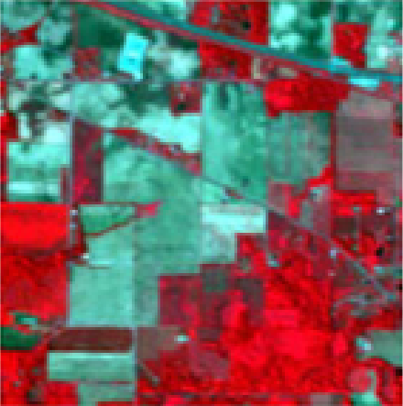
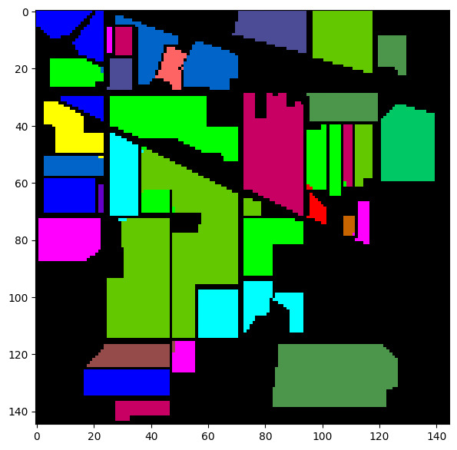
Classification Results

Slide 9
Conclusion
Hybrid SN is based on the hierarchical representation of spectral–spatial 3-D-CNN followed by a spatial 2-D-CNN, which are complementary to each other.
The proposed Hybrid SN model basically combines the complementary information of Spatio-spectral and spectral in the form of 3-D and 2-D convolutions, respectively.
The proposed model is computationally efficient than the 3-D-CNN model. It also shows the superior performance for small training data.

Slide 10
Reference
https://ieeexplore.ieee.org/stamp/stamp.jsp?tp=&arnumber=8736016&tag=1
https://github.com/gokriznastic/HybridSN/blob/master/supplementary-material.pdf

Slide 11
Thank You

